Slide 1
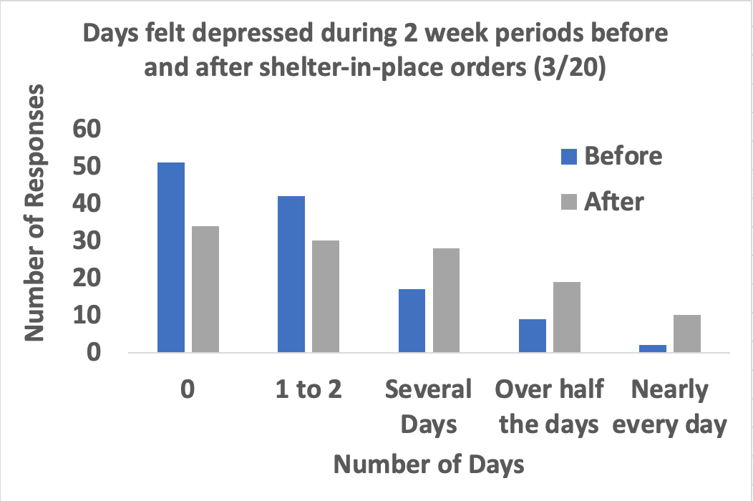

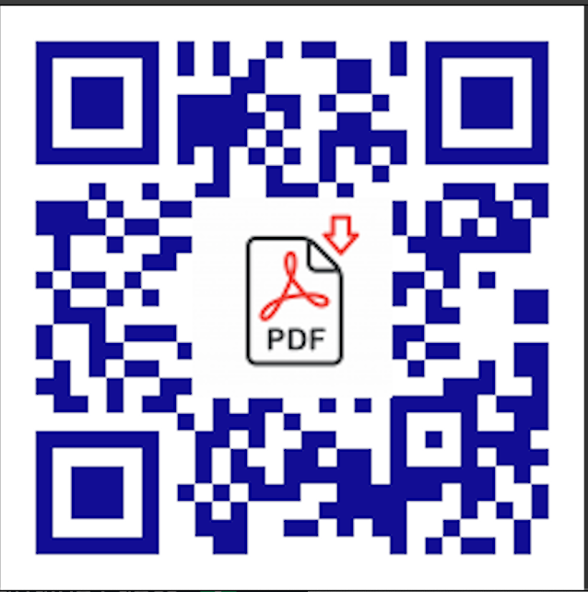
Main Findings:
Mental Health
Students felt more anxious and depressed after stay-at-home orders in March 2020 compared to before (z = 5.41, p <.01).
52 students indicated they were not aware of resources available for mental health support.
What are the needs in a rural community amidst COVID-19?
Results
The graph (left) shows increased number of days students felt depressed in March 2020. There were similar findings for students feeling more anxious. There was no significant difference by race/ethnicity.
Kiersten Kelly, MS4, UC Davis
Kim Bateman, PhD, Sierra College
Introduction
It is important to assess the needs of a rural community amidst pandemic to best allocate resources and assess whether they follow national trends.
The 24-hour crisis line received 620 calls between 01/20 and 06/20 compared to 706 calls in all of 2019. Calls were related to mental health, domestic violence, and substance abuse emergencies.
Discussion
Need further resource allocation in areas of food insecurity, mental health, and housing assistance.
Need further evaluation of impact of COVID-19 on Latino population in rural communities.
Ensure that students have access to tele-education (and tele-health) with switch to asynchronous learning and decrease in enrollment.
Hypothesis
The Latino population will be more impacted by stay-at-home orders and the needs of the community will mirror national trends of increased depression/anxiety, food and housing insecurity, and job loss.
Food insecurity:
29 students indicated not having enough money to buy food was a minor problem, for 7 it was a moderate problem, and for 1 it was a major problem.
The Sierra Community House began delivering 10,000 meals per week in March 2020. From 3/20-9/20, they served 2,187 unduplicated individuals
Methods
compared to 1,583 served from 3/19-9/19.
Substance use:
14% (all White) indicated that their substance use increased after stay-at-home orders.
Whites indicated that they consumed more alcohol per week compared to Latinos (z=2.19, p < .05).
A 43-item survey was developed with community partners and given to Sierra College students – 129 responses
Analyzed using Mann Whitney U and Wilcoxon signed-rank tests
Discussion with community partners regarding demand on resources

